Slide 1

Ames Housing Data Project
By Michael Ashley

Slide 2
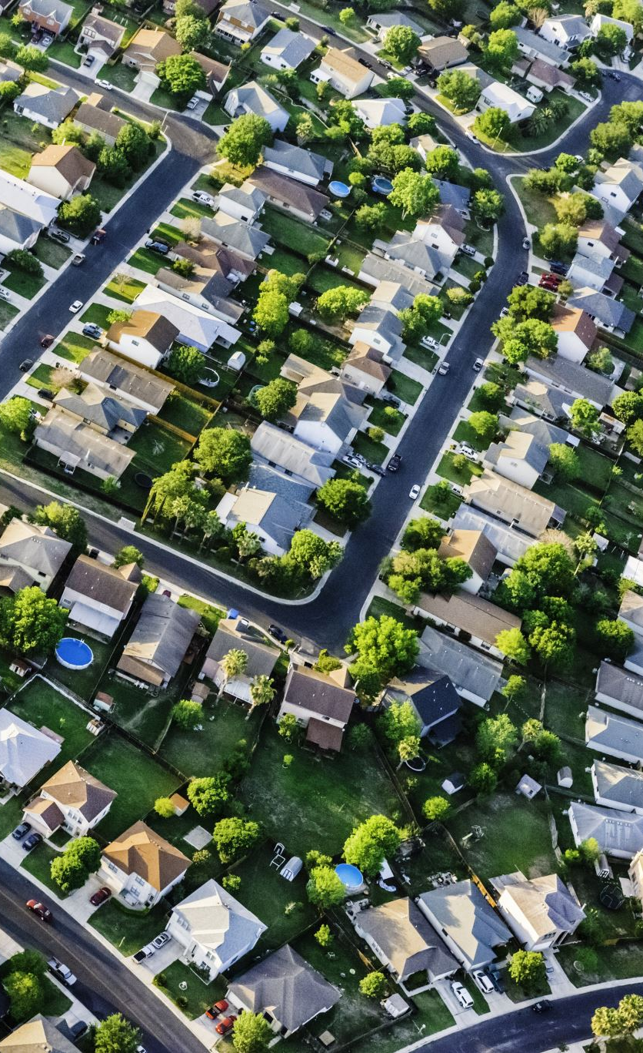
Overview
Residential property sales in Ames, Iowa from 2006-2010.
Analyze how various features can influence price.
Build a regression model to predict home prices
Evaluate the model's performance using standard metrics
Provide insights for real estate investors and buyers

Slide 3
Cleaning
All columns were converted to lowercase with underscores for consistency
Median frontage per neighborhood was used to impute missing values in ‘lot_frontage’
Missing values in ’alley’ were imputed with ‘No Alley’
All missing ‘masonry veneer types’ occurred when ‘masonry veneer area was 0 – ‘No Veneer’.
Missing basement data was imputed with 0.0 where no basement existed. Row 1341 was dropped.
One missing value in ‘electrical’ was imputed with the most frequent system – ‘SBrkr’
Missing ‘fireplace_qu’(quality) values occurred when the number of ‘fireplaces’ was 0. Imputed with ‘None’
Missing values in garage-related categorical columns were aligned with missing or 0 values in garage-related numerical columns (no garage present) and was imputed with ‘None’
Missing ‘pool_qc’ (quality) values only occurred when ‘pool_area’ was 0. Imputed with ‘None’
Missing values in ‘fence’ and ‘misc_feature’ were treated as an absence and were imputed with ‘None’

Slide 4
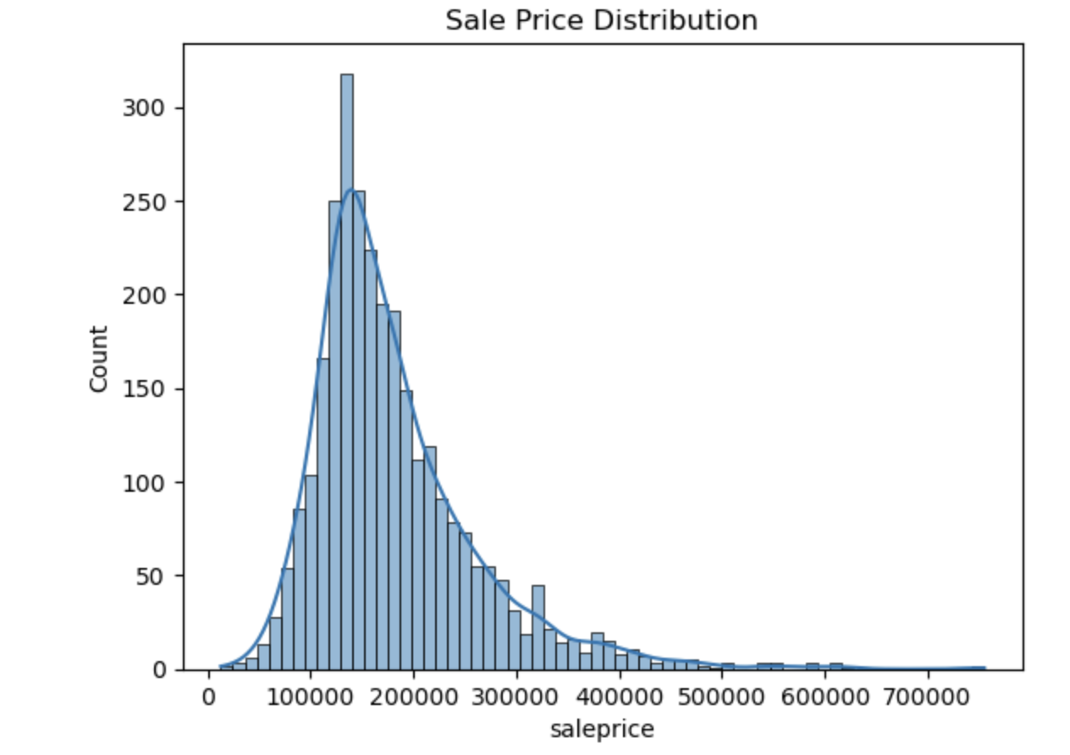
Exploratory data analysis
Sale price histogram
Most homes sell for between $100-$150K
Outliers exist on the higher end

Slide 5
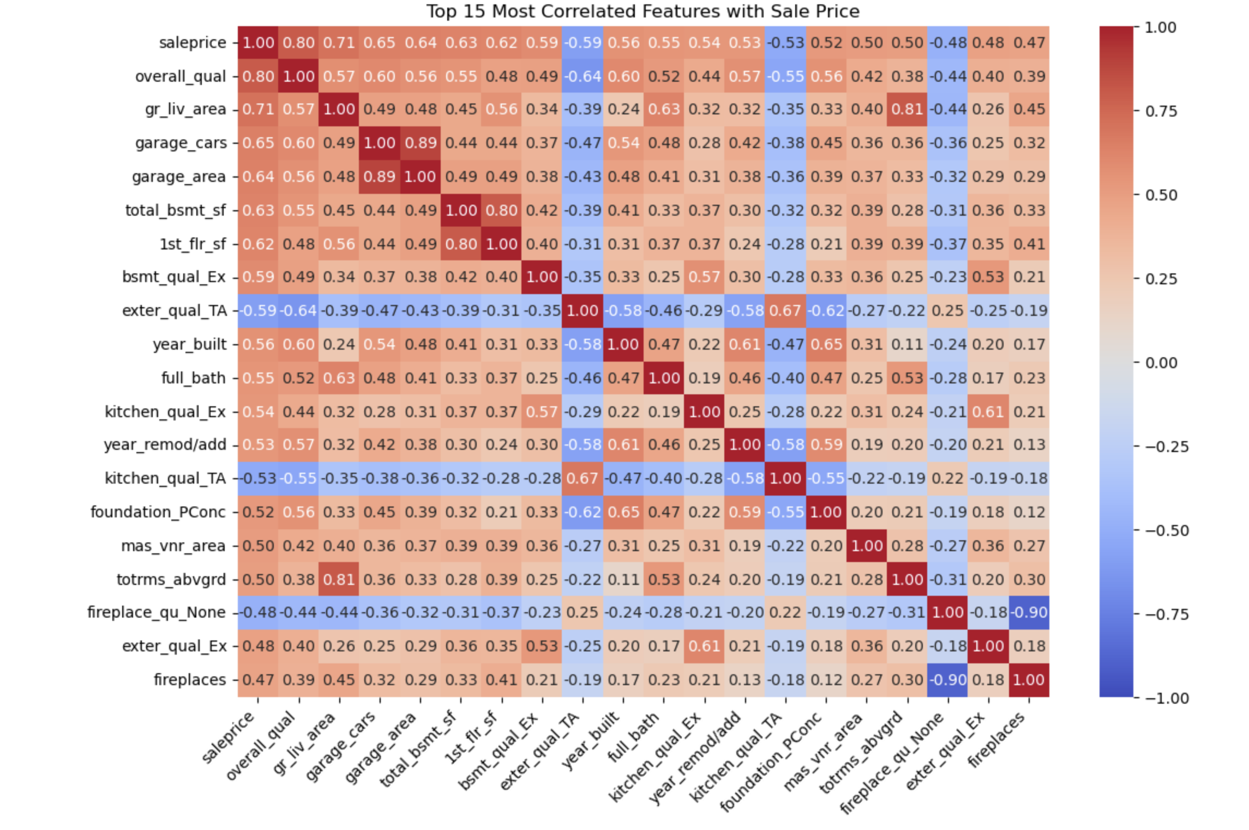
Heat Map
Top 15 most correlated features with sale price
- Overall Quality - Above Ground Living Area - square footage excluding basement
- Garage Capacity
- Total Basement Size

Slide 6
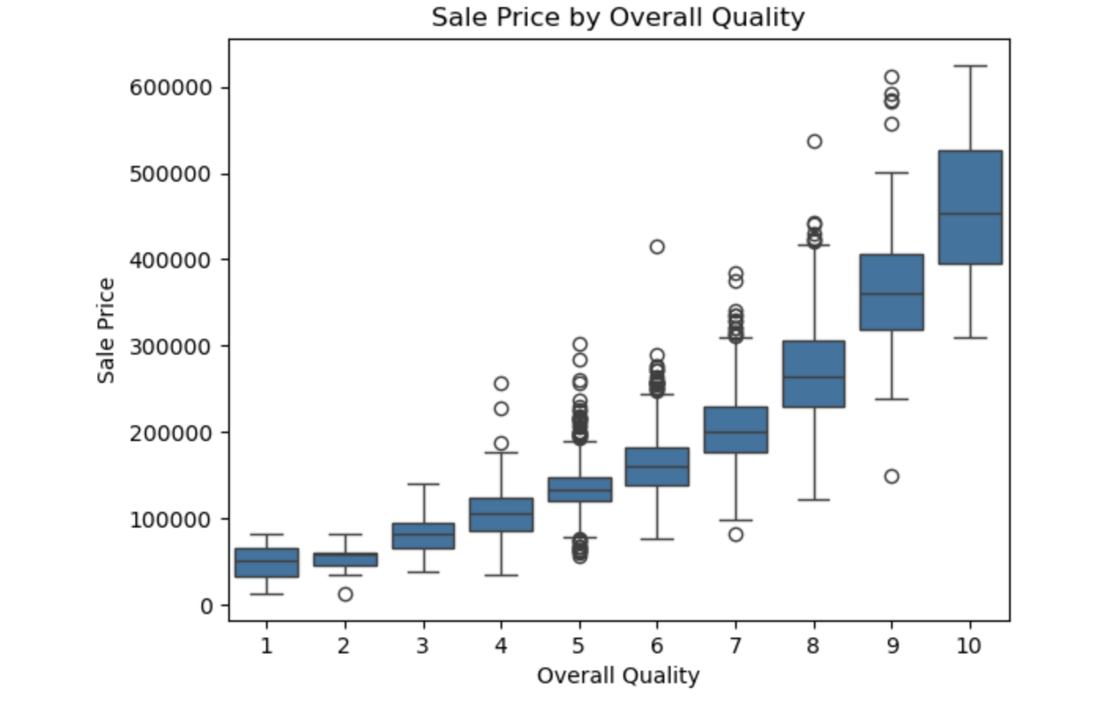
Sale price by overall quality
Distribution of home prices across quality ratings
Clear positive relationship quality and sale price
Higher quality homes sell for more

Slide 7
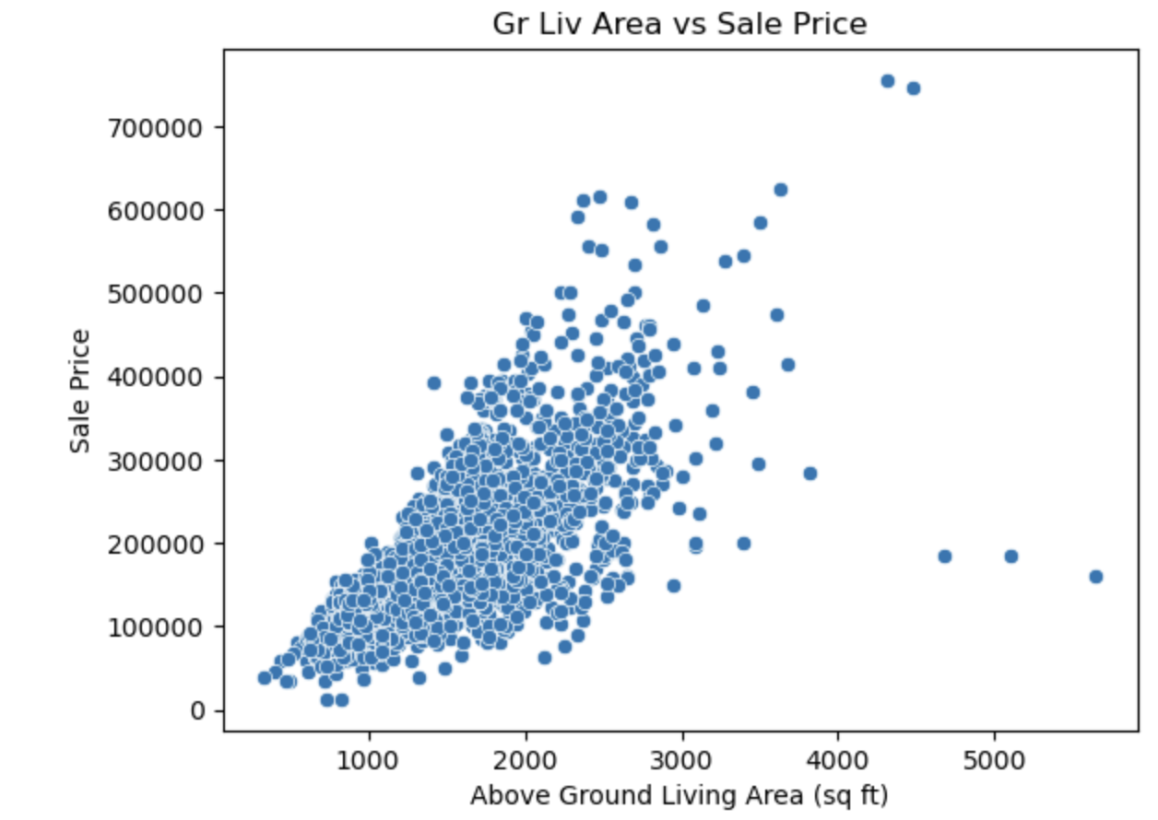
Above ground living area vs sale price
Strong positive relationship between above ground living area and sale price
Indicates that larger homes generally sell for more
Visual confirmation of a linear trend, supporting sustainability for linear regression
A small number of extreme outliers were removed for modeling (gr_liv_area > 4000 sq ft, saleprice > $700,000

Slide 8
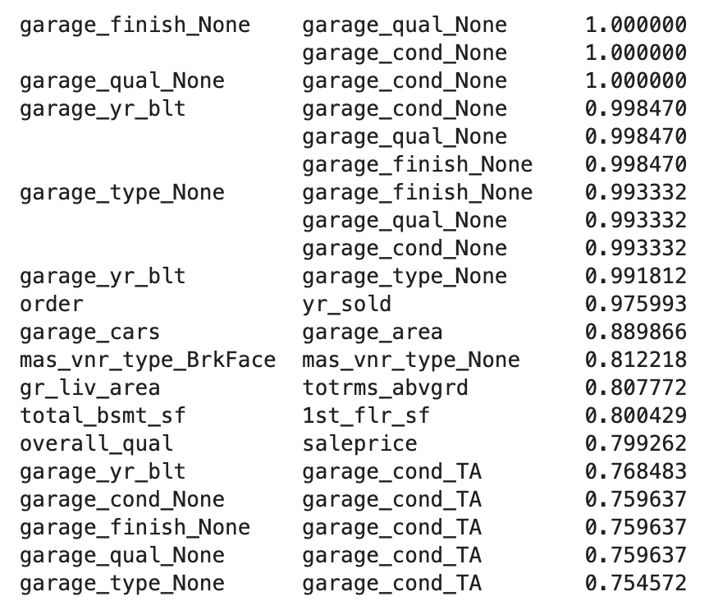
Multicollinearity
Occurs when two or more features are highly correlated with each other
This can distort coefficient estimates in a linear regression model
- Step 1.
Identified highly correlated pairs (r>0.75)
Strong redundancy among garage-related variables
- Step 2
• Calculate the variance inflation factor (VIF)
• Flagged features with VIF >75 as multicollinear and dropped the columns that had an infinite VIF.

Slide 9
One Hot Encoding
Created many new binary features from categorical data
This did increase the risk of multicollinearity
Used VIF to detect and drop highly collinear features
However, encoding after VIF may have reintroduced some multicollinearity
Trade off accepted to preserve important categorical information
Despite this, the model achieved strong predictive performance (R2 = 0.9, RMSE < baseline)
Suggests multicollinearity did not meaningfully harm the model's accuracy

Slide 10
Metrics
The model achieved an r2 score on the test set. Indicating strong predictive performance.
93% of the variability in sale prices can be explained by the features in the model
The model achieved a train RMSE score of 19,723.3 and test RMSE score of 21,497.4
Indicates consistent performance and no signs of overfitting
On average the model’s predictions are within $20k of the actual price
A baseline strategy (predicts the mean of the target variable) achieved a test RMSE score of 84,319.7, showing my model is significantly more accurate

Slide 11
Coefficient analysis
Many of the largest values were tied to rare OHE categories such as specific pool qualities or unusual garage types
Appeared in very few homes, likely reflects overfitting to small data patterns, rather than true predictive power
Focused on more stable, high frequency features such as overall quality and above ground living area.
These features were present in every home
Continuously scaled and not the result of binary OHE
Holding all else constant, the model estimates that for every additional square foot of above ground living area the sale price is increased by $66.44
Holding all else constant, the model estimates that for every 1-point increase in overall quality, the sale price increases by $6902

